Slide 1
If you are a new course registree please come talk to us
Also, if anyone is in the 11:00 discussion, but could come to the 10:00 instead please come talk to us!

Slide 2
Final thoughts on eating and appetite

Slide 3
 | Observational Study | Randomized Controlled Trial | Overall evidence
Breakfast | People with lower BMI are more likely to consume breakfast regularly | Breakfast → more activity; no breakfast → partial compensation | Inconclusive
Eating near bedtime | Shift workers gain weight over time; rodents provided food access for 24h ate more than those with food access for 12h | Intermittent fasting diets show no advantage Sleep studies → weight loss, may be decreased night eating | Inconclusive
Snacking | Snacking has increased significantly over past decades; poor compensation for snack food intake | No association | Inconclusive
Fast food | Among adults, those with higher BMIs report more frequent fast food consumption; “remainder of the diet” may explain | Adolescents fed large portions of fast food could not compensate for extra calories; compensation particularly poor for overweight adolescents | Inconclusive
Family meals | More frequent family meals associated with lower BMIs among children and adolescents | Increase in family meal frequency not associated with lower obesity risk in children | Inconclusive

Slide 4
Appetite

Slide 5
So it’s not that overweight children are eating fattier or more sugary foods. They just eat a little bit more at each meal or snack. The same appears true for grown-ups. “It’s not just what you eat, but how you eat,” says Llewellyn.
Danielle Reed at the Monell Chemical Senses Center in Philadelphia, Pennsylvania, likens the propensity for overeating to genetic differences in vision.
Just as someone who sees more colours might linger longer at the Louvre than someone who is colour-blind, so someone who has the genes to savour the “sensory loveliness of food” might take those extra bites even after they’re full.

Slide 6
Appetitive traits and eating behaviors
Food responsiveness
Satiety responsiveness
Emotional overeating
Enjoyment of food
Disinhibited eating
Overeating
Binge eating
Eating in the absence of hunger
Energy consumed from snack foods after eating a satiating meal

Slide 7
Physical Activity and Energy Expenditure

Slide 8
Learning Objectives
Describe what is meant by energy expenditure and how it relates to energy balance
Distinguish between methods to evaluate energy expenditure, including advantages and disadvantages of each (step counts, doubly-labelled water, indirect calorimetry)
Define the components of total daily energy expenditure
Assess how each component is affected by diet, genetics, sex, age and activity levels
Explain the relationship between energy expenditure and obesity
Understand the associations between physical activity and risk of obesity
Assess how total daily energy expenditure changes during weight gain or loss and how this relates to weight loss efficacy
Summarize the health benefits of exercise, independent of changes in energy expenditure

Slide 9
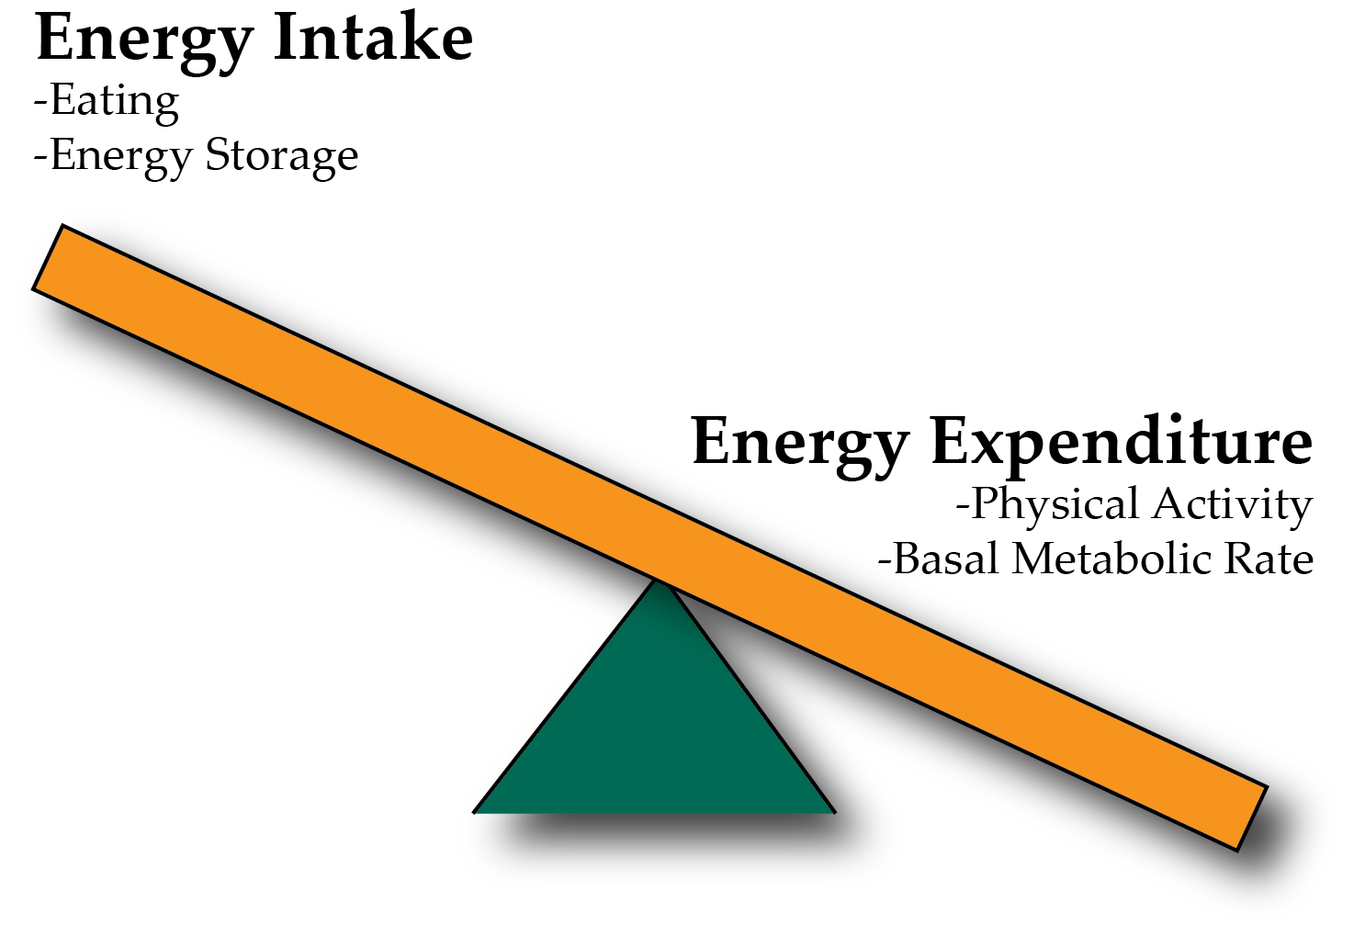
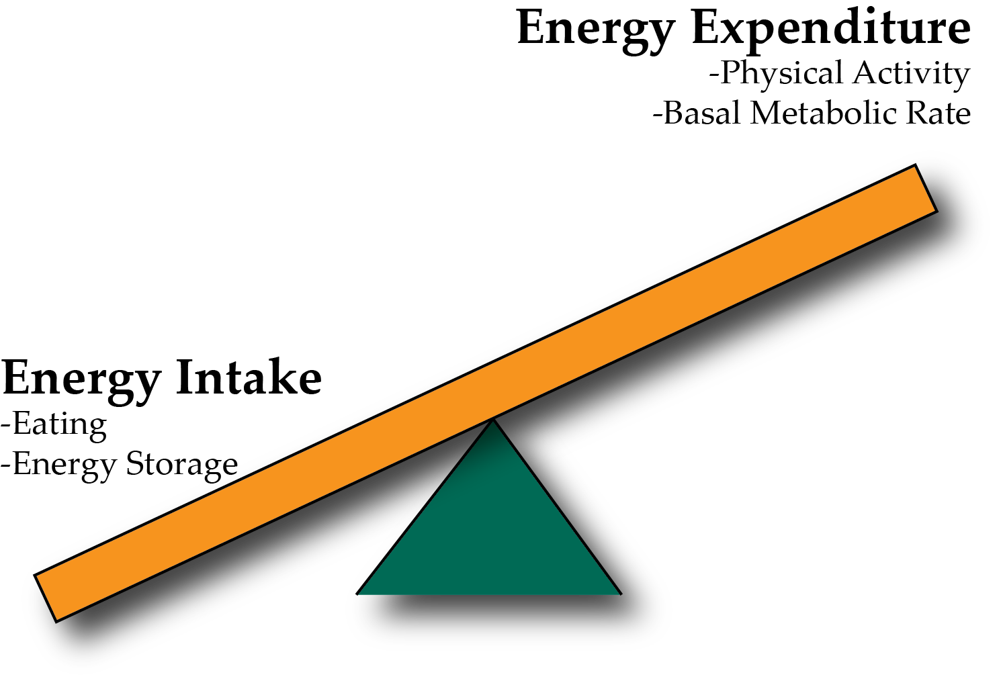
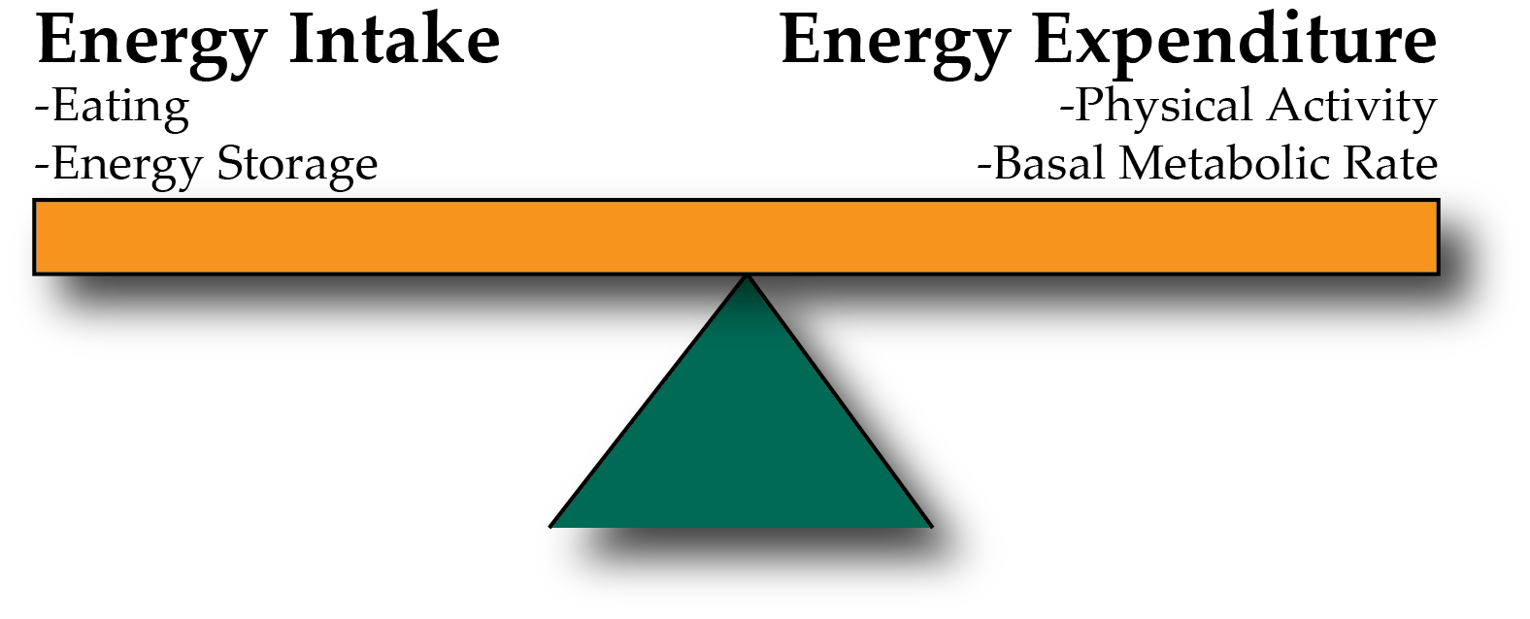
Energy Balance and Obesity
Positive Energy Balance – Weight Gain
Negative Energy Balance – Weight Loss
Notes:
Be here at 9:20

Slide 10
Energy Expenditure

Slide 11
Energy Expenditure, Heat and Oxygen Consumption
Energy cannot be created or destroyed but can be interconverted
Nutrients -> ATP -> Muscle Contraction
At each step some energy is lost as heat
Therefore fundamentally, energy expenditure is measured by heat generation, also known as Thermogenesis

Slide 12
What is heat and why is it relevant for energy expenditure?
Thermogenesis is the generation of heat from metabolic processes.
Metabolic efficiency is the percent of energy intake that is stored
Metabolic inefficiency is the percent of energy intake that is released (either as heat, or excreted)
Most of energy captured as ATP/NADH/FADH₂ but for each reaction a small amount is released as heat

Slide 13
Parts of the Metabolic Rate Metabolic Rate
Energy Expenditure Component | Increased by
Exercise Activity Thermogenesis (NEAT/EAT) | Exercise and movement
Thermic Effect of Food (TEF) | Protein in Meal, Insulin Sensitivity, Meal Size
Basal Metabolic Rate | Young Age, Sex (M), Lean Mass, Set Point
Maclean PS, Bergouignan A, Cornier M-A, Jackman MR. Biology’s response to dieting: the impetus for weight regain. Am. J. Physiol. Regul. Integr. Comp. Physiol. 2011;301(3):R581–R600. http://dx.doi.org/10.1152/ajpregu.00755.2010
Notes:
Impact of weight loss on the components of total energy expenditure (TEE). Energy-restricted weight loss impacts every component of energy expenditure. The absolute levels of resting energy expenditure (REE) decline from a loss of metabolic mass and enhanced metabolic efficiency. Nonresting energy expenditure (NREE) declines, unless the level of physical activity and its associated exercise activity thermogenesis (EAT) are substantially increased. This increase must overcome the decline in the TEF that results from lower energy consumption and a decline in nonexercise activity thermogenesis (NEAT) related to loss in overall mass. Increased energetic efficiency of EAT, NEAT, and potentially TEF contribute to the overall decline in NREE.

Slide 14
Major Determinants of Energy Expenditure
Amount of metabolically active tissue (fat-free mass)
How inefficient that tissue is
In terms of weight loss, inefficiency is good
Strong relationship between REE and Fat-Free Mass
Modified by
Age (declines with age)
Sex (~11% higher in males)
Genetics (V_{g} ~ 11%)
Illner K, Brinkmann G, Heller M, Bosy-Westphal A, Muller MJ. Metabolically active components of fat free mass and resting energy expenditure in nonobese adults. Am J Physiol Endocrinol Metab. 2000; 278: E308-15.
Notes:
The major factors that contribute to the BMR are age (declines with age), sex (approximately 11 % higher in males) and body mass, particularly fat-free (or lean) mass. Up to 85 % of the variance in BMR can be explained by these factors,

Slide 15
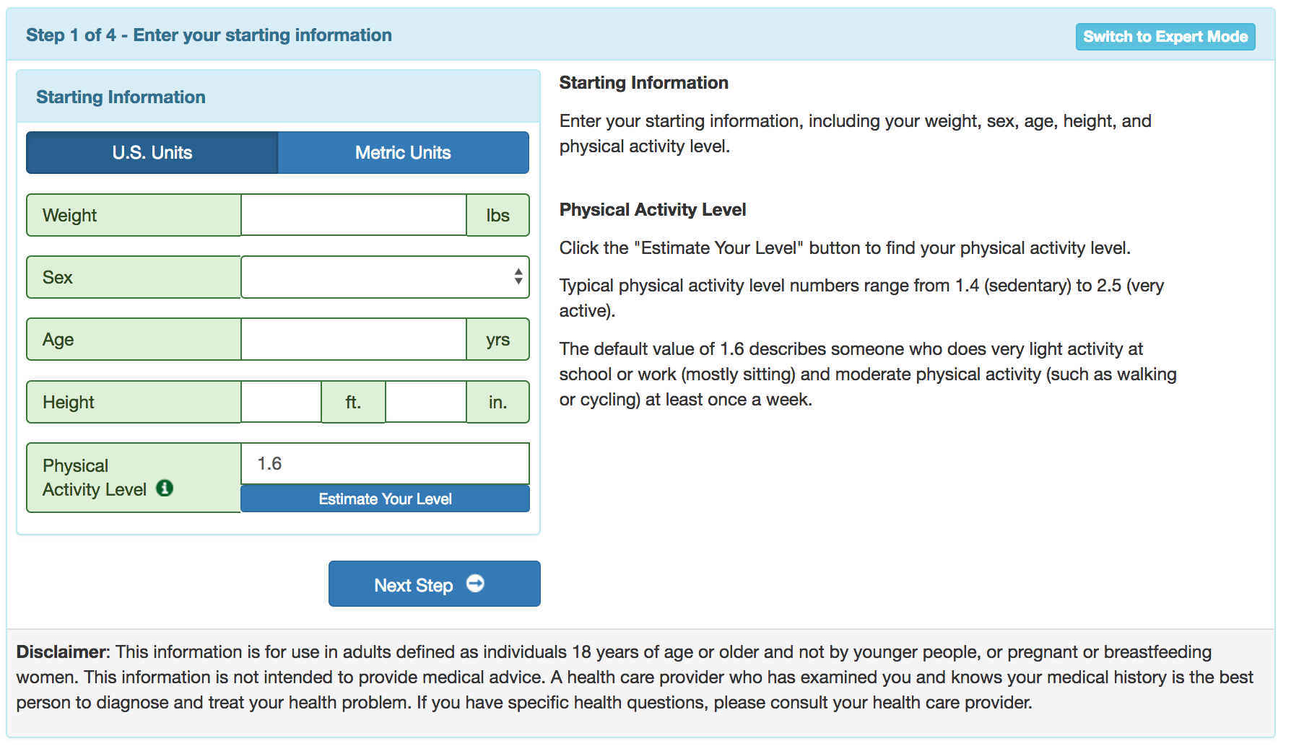
Estimating Total Daily Energy Expenditure
Illner K, Brinkmann G, Heller M, Bosy-Westphal A, Muller MJ. Metabolically active components of fat free mass and resting energy expenditure in nonobese adults. Am J Physiol Endocrinol Metab. 2000; 278: E308-15.
Supertracker by the NIH: https://www.supertracker.usda.gov/bwp/index.html
Notes:
The major factors that contribute to the BMR are age (declines with age), sex (approximately 11 % higher in males) and body mass, particularly fat-free (or lean) mass. Up to 85 % of the variance in BMR can be explained by these factors,

Slide 16
How do we measure metabolic rates?
Doubly Labelled Water

Slide 17
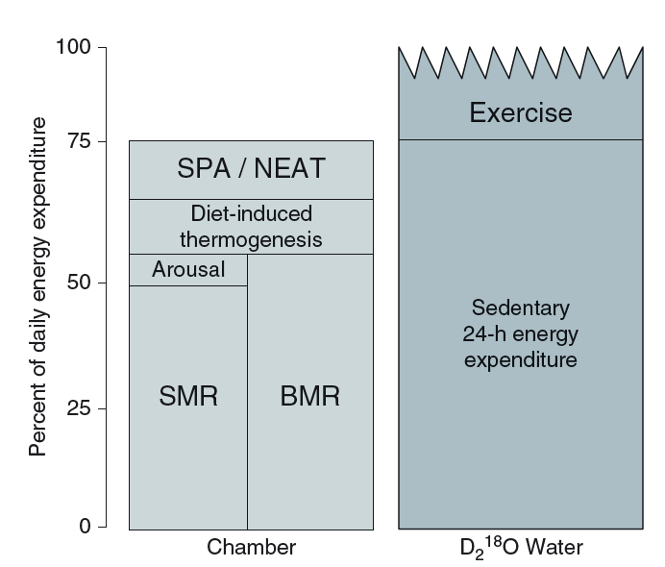
Think, Pair, Share: Strengths and Limitations of Indirect Calorimetry vs Doubly Labelled Water
Think about it yourself for 2 mins
Talk to someone near you for 2 mins
Bring it back to the group
Notes:
Be here at 9:30

Slide 18
Trends in Physical Activity

Slide 19
Trends in Workplace Physical Activity
Church TS, Thomas DM, Tudor-Locke C, Katzmarzyk PT, Earnest CP, Rodarte RQ, Martin CK, Blair SN, Bouchard C. Trends over 5 decades in U.S. occupation-related physical activity and their associations with obesity. PLoS One. 2011; 6: 1–7. doi: 10.1371/journal.pone.0019657.

Slide 20
Leisure Time Physical Activity
National Health Interview Survey, 2016

Slide 21
Effectiveness of Physical Activity in Weight Loss
https://www.youtube.com/watch?v=eXTiiz99p9o
Notes:
Play video if here at 9:45

Slide 22
How do you think over-eating alters the basal metabolic rate?
I think metabolic rate would be lower after over-eating
I think metabolic rate would be higher after over-eating
What do you think fasting or caloric restriction would do to the metabolic rate?
Notes:
Be here at 9:50

Slide 23
Over/underfeeding and metabolic rates
Leibel RL, Rosenbaum M, Hirsch J. Changes in energy expenditure resulting from altered body weight. N. Engl. J. Med. 1995;332(10):621–8. http://dx.doi.org/10.1056/NEJM199503093321001

Slide 24
The Biggest Loser Follow-Up Study
Fothergill E, Guo J, Howard L, Kerns JC, Knuth ND, Brychta R, Chen KY, Skarulis MC, Walter M, Walter PJ, Hall KD. Persistent metabolic adaptation 6 years after “The Biggest Loser” competition. Obesity. 2016; 24: 1612–9. doi: 10.1002/oby.21538.
Notes:
Those with sustained weight loss, did so even in spite of a more pronounced reduction in RMR after 6 years

Slide 25
Benefits of Physical Exercise
Flexibility
Strength
Mood
Cardiovascular health
Benefits at all BMI categories
Blair SN, Kohl HW, Paffenbarger RS, Clark DG, Cooper KH, Gibbons LW. Physical fitness and all-cause mortality. A prospective study of healthy men and women. JAMA. 1989; 262: 2395–401. doi: 10.1001/jama.1989.03430170057028.

Slide 26
Learning Objectives
Describe what is meant by energy expenditure and how it relates to energy balance
Distinguish between methods to evaluate energy expenditure, including advantages and disadvantages of each (step counts, doubly-labelled water, indirect calorimetry)
Define the components of total daily energy expenditure
Assess how each component is affected by diet, genetics, sex, age and activity levels
Explain the relationship between energy expenditure and obesity
Understand the associations between physical activity and risk of obesity
Assess how total daily energy expenditure changes during weight gain or loss and how this relates to weight loss efficacy
Summarize the health benefits of exercise, independent of changes in energy expenditure

